Slide 1
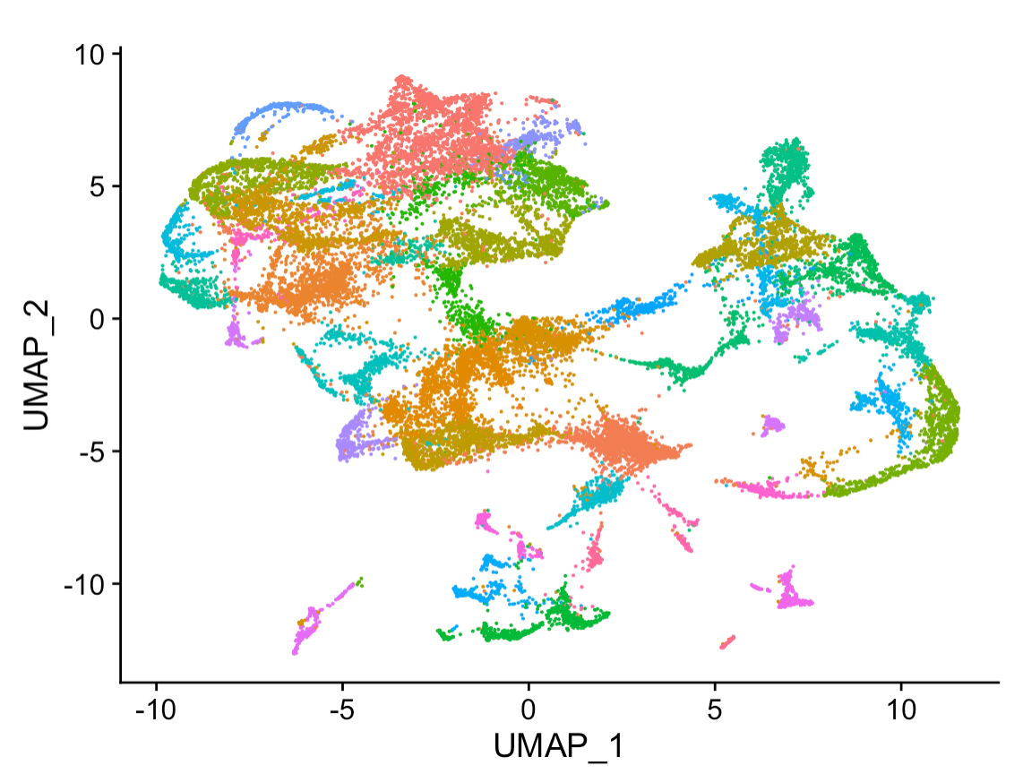
What is Machine Learning
Jake Searcy
Assistant Research Professor of Data Science

Slide 2
Prompt: Why is it important for bench scientists to learn about machine learning?
GPT-3 There are many reasons why bench scientists should learn about machine learning. Machine learning can help bench scientists automate data analysis, find patterns in data more quickly, and make better predictions. Additionally, machine learning is a rapidly growing field, and bench scientists who are familiar with machine learning will be better positioned to take advantage of new opportunities as they arise.
Generative Pre-trained Transformer 3 (GPT-3) is an autoregressive language model that uses deep learning to produce human-like text.

Slide 3
Prompt: Some of the most useful applications of Machine Learning in the Life Sciences are
GPT3
1. Diagnosis and treatment of disease
2. Development of new drugs and therapies
3. Personalized medicine
4. Predictive analytics for clinical trials 5. Population health management

Slide 4
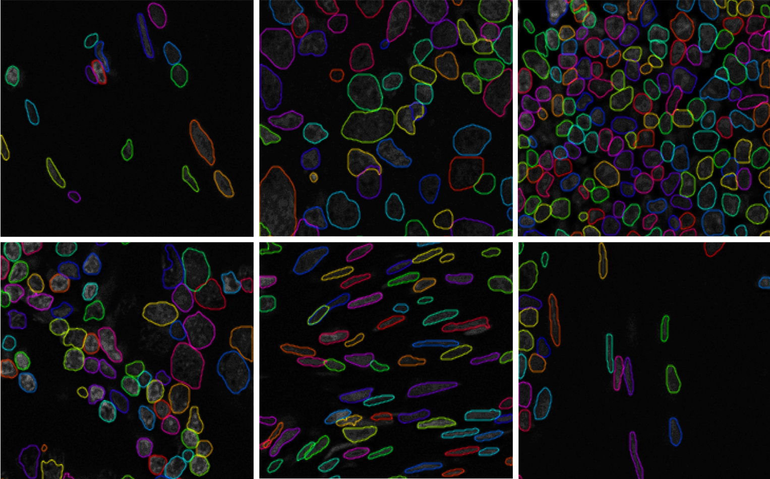
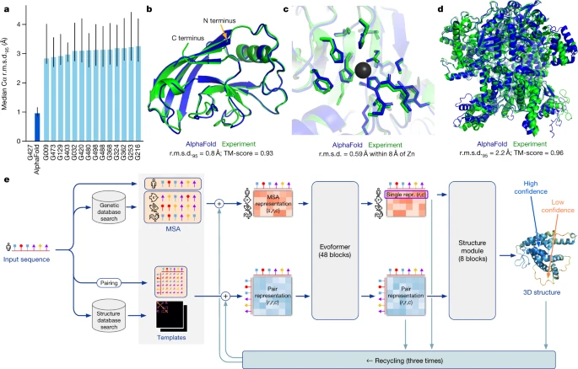
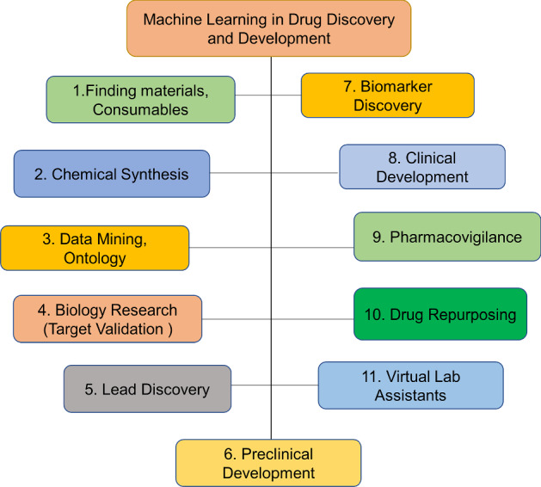
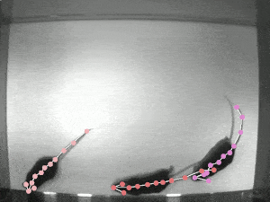
Alpha Fold - Protein Folding : https://www.nature.com/articles/s41586-021-03819-2
https://michaellee1.github.io/CellSegSite/index.html
https://www.ncbi.nlm.nih.gov/pmc/articles/PMC8356896/figure/Fig1/
http://www.mackenziemathislab.org/deeplabcut

Slide 5
What is Machine Learning
Machine learning (ML) is a lot like programing
It’s a series of technique for telling a computer how to do something
Instead of writing an algorithm with code you create a system that can learn an algorithm from data
Often is not the right choice
Training an ML model to add numbers
Would take a lot of work
And would not be as accurate a
Perfect when you have data but no algorithm
Besides quick coding fingers, look for a personality that can cope with failure. You almost never know what you’re doing, even if you think you do.
--Cassie Kozyrkov Chief Decision Intelligence Engineer at Google

Slide 6
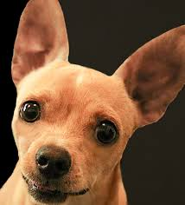

Thought Experiment
How would you write an algorithm to tell the difference between cats and dogs

Slide 7
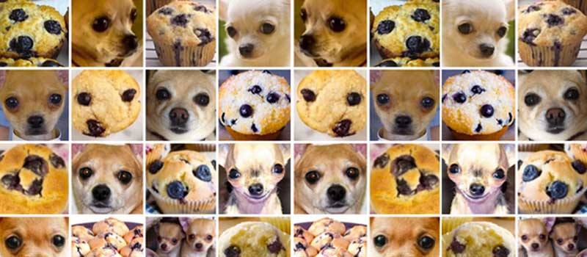
Still an Algorithm
Algorithms can have bugs
Bugs in ML often occur in data

Slide 8

How Does it Work

Slide 9
How Does it Work
All ML Algorithms Require
Data
Goal
Generally ‘learn’ through repeated trial and error
Selecting the Goal and Data are often the most important parts of an ML project
Often understood the least by ML experts

Slide 10
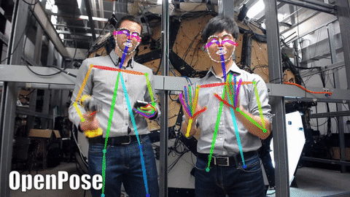
Data - Supervised
Just a series of example inputs and a series of example outputs
What are the inputs and outputs here?

Slide 11
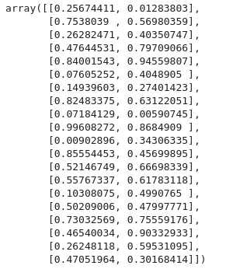
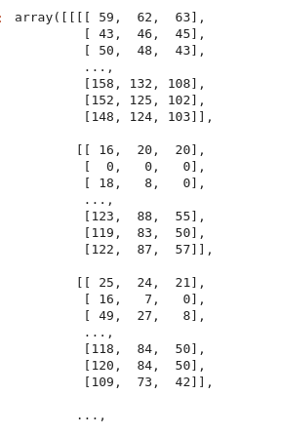
Data - Supervised
Locations X,Y
Pixels

Slide 12
Example 2
What are the inputs and outputs here?
Prompt: Why is it important for bench scientists to learn about machine learning?
GPT-3 There are many reasons why bench scientists should learn about machine learning. Machine learning can help bench scientists automate data analysis, find patterns in data more quickly, and make better predictions. Additionally, machine learning is a rapidly growing field, and bench scientists who are familiar with machine learning will be better positioned to take advantage of new opportunities as they arise.

Slide 13
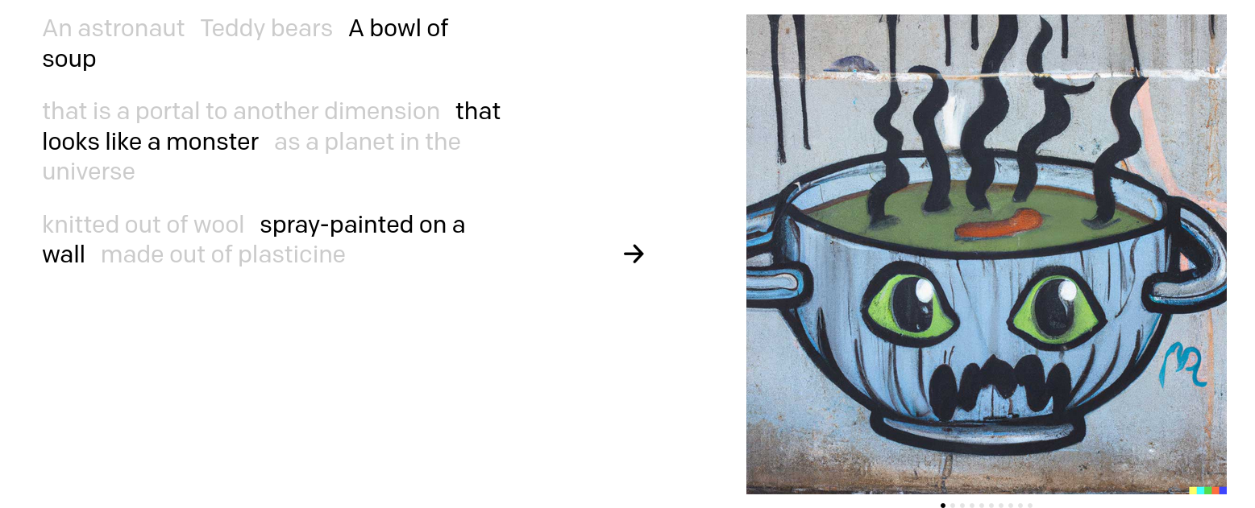
Example 3
https://openai.com/dall-e-2/

Slide 14
Supervised Learning
Lots of ML algorithms for utilizing all kinds of data in all kinds of combinations
This can be fun, creative and useful and creating the training datasets is the first step.

Slide 15
Common Vocab
x’s - often used to represent input data
y’s - often used to represent target labels
From x predict y ( P(y|x) )
Classification
y is a class label (cat,dog etc.)
Regression
y is a continuous variable (location, miles per gallon etc.)

Slide 16
Supervised Goals
Classification
y’s - often used to represent target labels
From x predict y ( P(y|x) )
Classification
y is a class label (cat,dog etc.)
Regression
y is a continuous variable (location, miles per gallon etc.)

Slide 17
Unsupervised Learning
Just examples No-Labels
Dimensionality Reduction
Your data has too many variables
Clustering
You want to group your data into categories

Slide 18
Dimensionality Reduction
Picture of a Line (500x500 pixels=250,000 Numbers)
Equation: y=m*x+b (2 numbers)
Both have the same information in different formats
It’s often a lot easier to analyze 2 number than 250,000

Slide 19
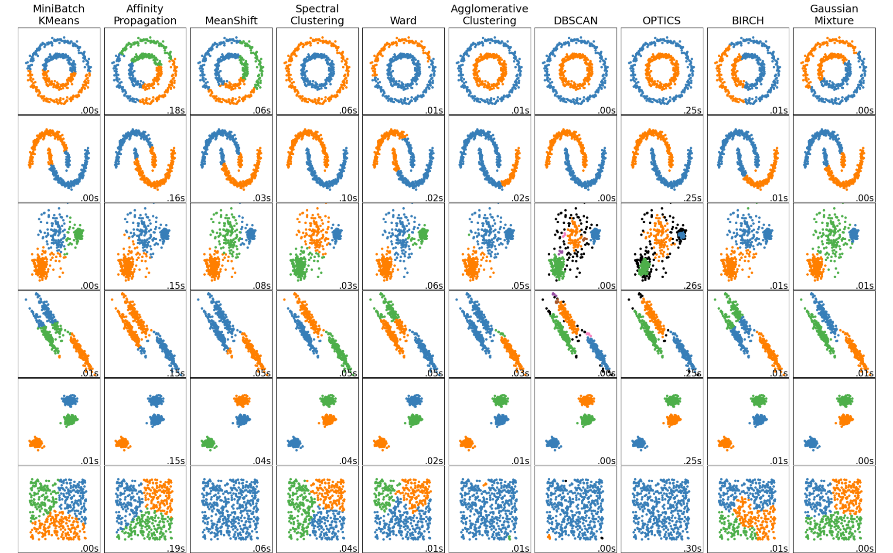
Clustering
Group your data points together
https://scikit-learn.org/stable/auto_examples/cluster/plot_cluster_comparison.html

Slide 20
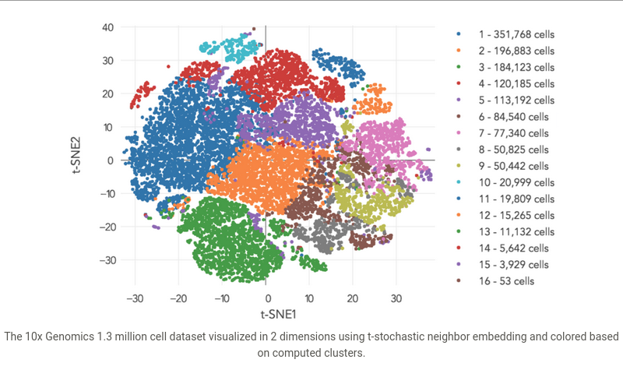
Both at once
http://data-science-sequencing.github.io/Win2018/lectures/lecture19/

Slide 21
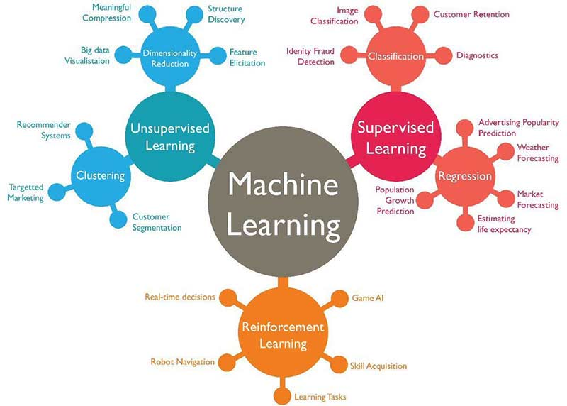
What technique depends on the problem
Image Source

Slide 22
Algorithms
Algorithms vary based on there goal, but also based on the kind of data they can use
Structured Data
Fixed number of features
Unstructured Data
Text
Images
Movies

Slide 23
Traditional ML
Commonly used algorithms primarily using structured data
Random Forests
Support Vector Machines (SVM)
K-Means Clustering
Principal Component Analysis

Slide 24
Feature Engineering
A lot of traditional ML relies on extracting structured data from unstructured data
Example Bag of words
Raw: “This is a sentence for a test”
Structured word counts:
[This : 1, is : 1 , a : 2 , sentence: 1, dog: 0, other :2 ]

Slide 25

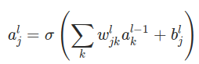
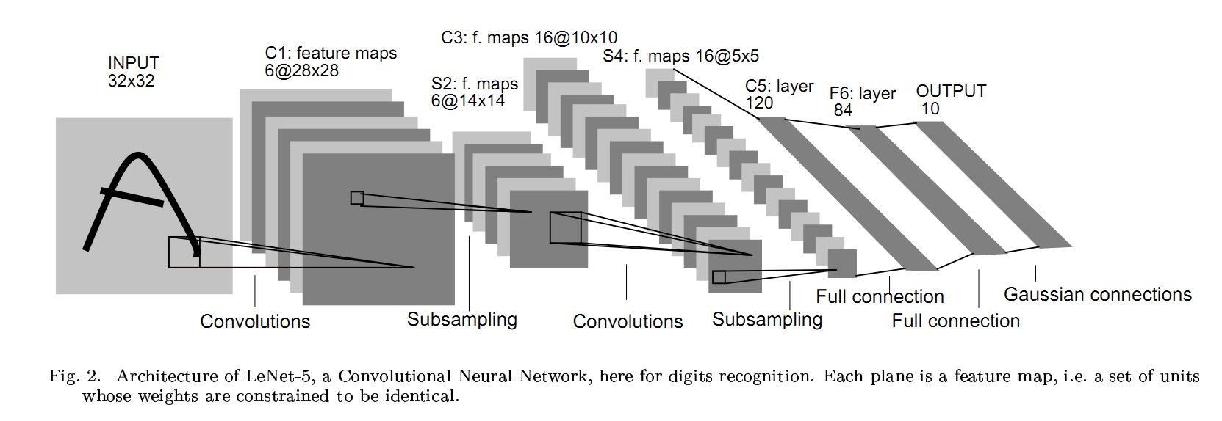
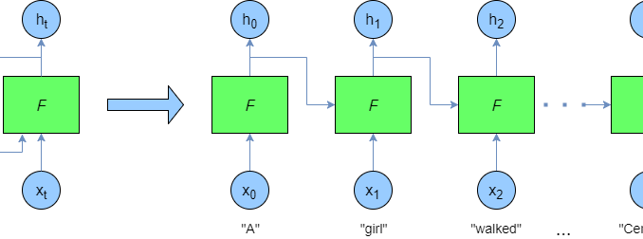
Deep Learning
Primarily used with unstructured data
No Feature Engineering
Built with Layers
Think lego blocks that can be used to utilize different types of data

Slide 26
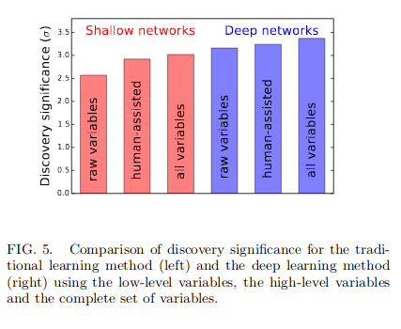
DNN Advantages
Often can lead to better results than human crafted algorithms
Provided the data is sufficient
Can ingested huge varieties of raw data with limited or no preprocessing
Text
Images
Sounds
etc.
10.1103/PhysRevLett.114.111801

Slide 27
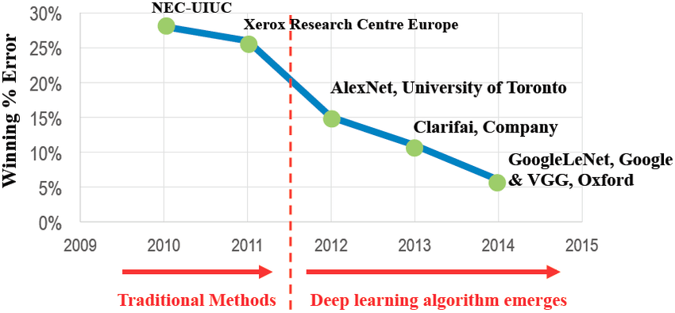
Images
Rule based algorithms are difficult to design images, deep learning wins
Image-net Challenge: Identify the subject of an image out of 1000 classes
Human Error

Slide 28
When should you use Deep Learning
When you have a lot of data
DNN improve with data for longer than other traditional ML models
When you have no traditional models
traditional models aren’t preformant
When your data is unstructured
Images, text, sound, etc.
When your optimization goal can be computed quickly or approximately
Likelihoods can be approximated in mini-batches
Differential goals can be learned with back-prop
Differential goals can be
Non-Differential use Reinforcement learning

Slide 29


Software Tools
Tons of implementations of basic ML tools
Matlab
R
STAT
SAS
Most ML research and development is happening in two package
Tensorflow
PyTorch
(R has interfaces to both the above)
Tensorflow

Slide 30
Hardware Tools
GPUS
Nvidia GPUs are the primary tools for machine learning
Primarily due to CUDA
CPUS
Fine for smaller models, can’t compete with GPUS for larger models
Tensor Cores
Next generation of core highly optimized for tensor operations used in Deep Learning
Google’s TPUs
Nvidia’s RTX/Volta lines
FP16 only
Others
FPGAs
Graph Cores and other custom chips
As a user CPUS are a good place to start, and GPUs will be the main workhorse

Slide 31
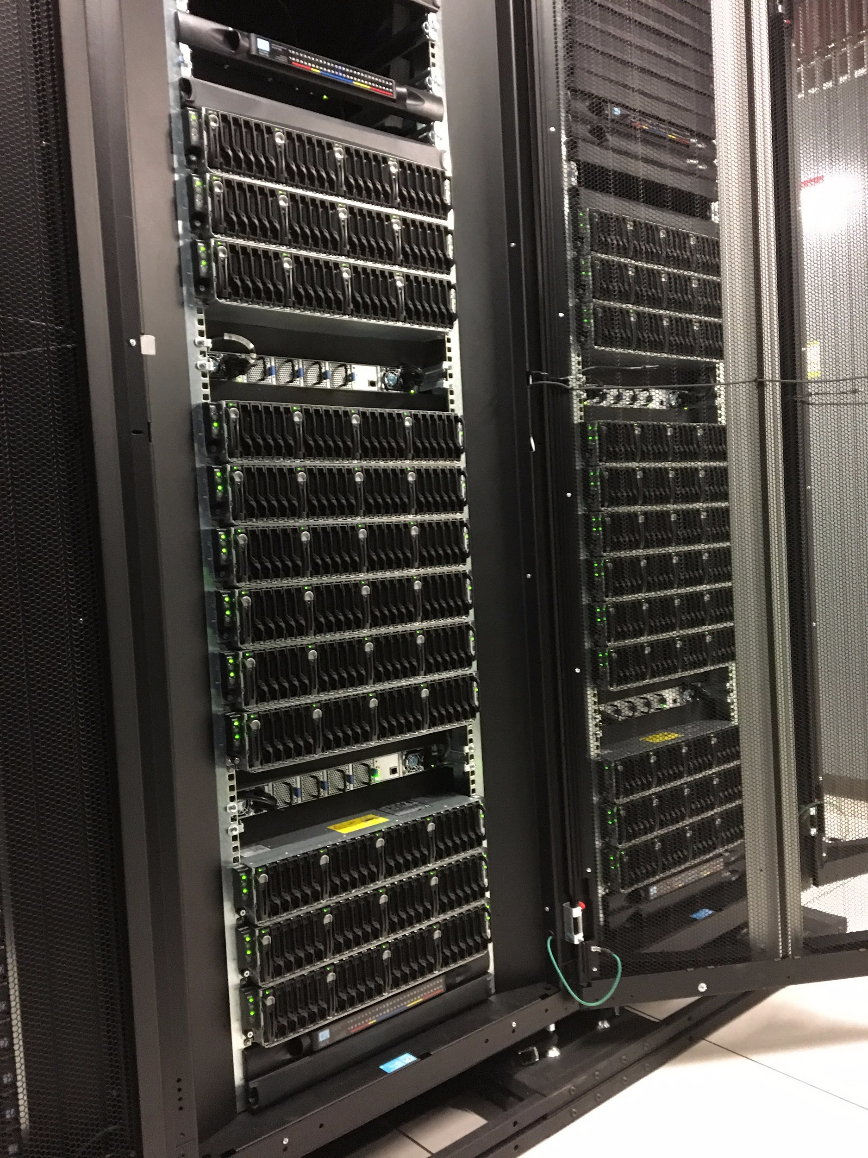
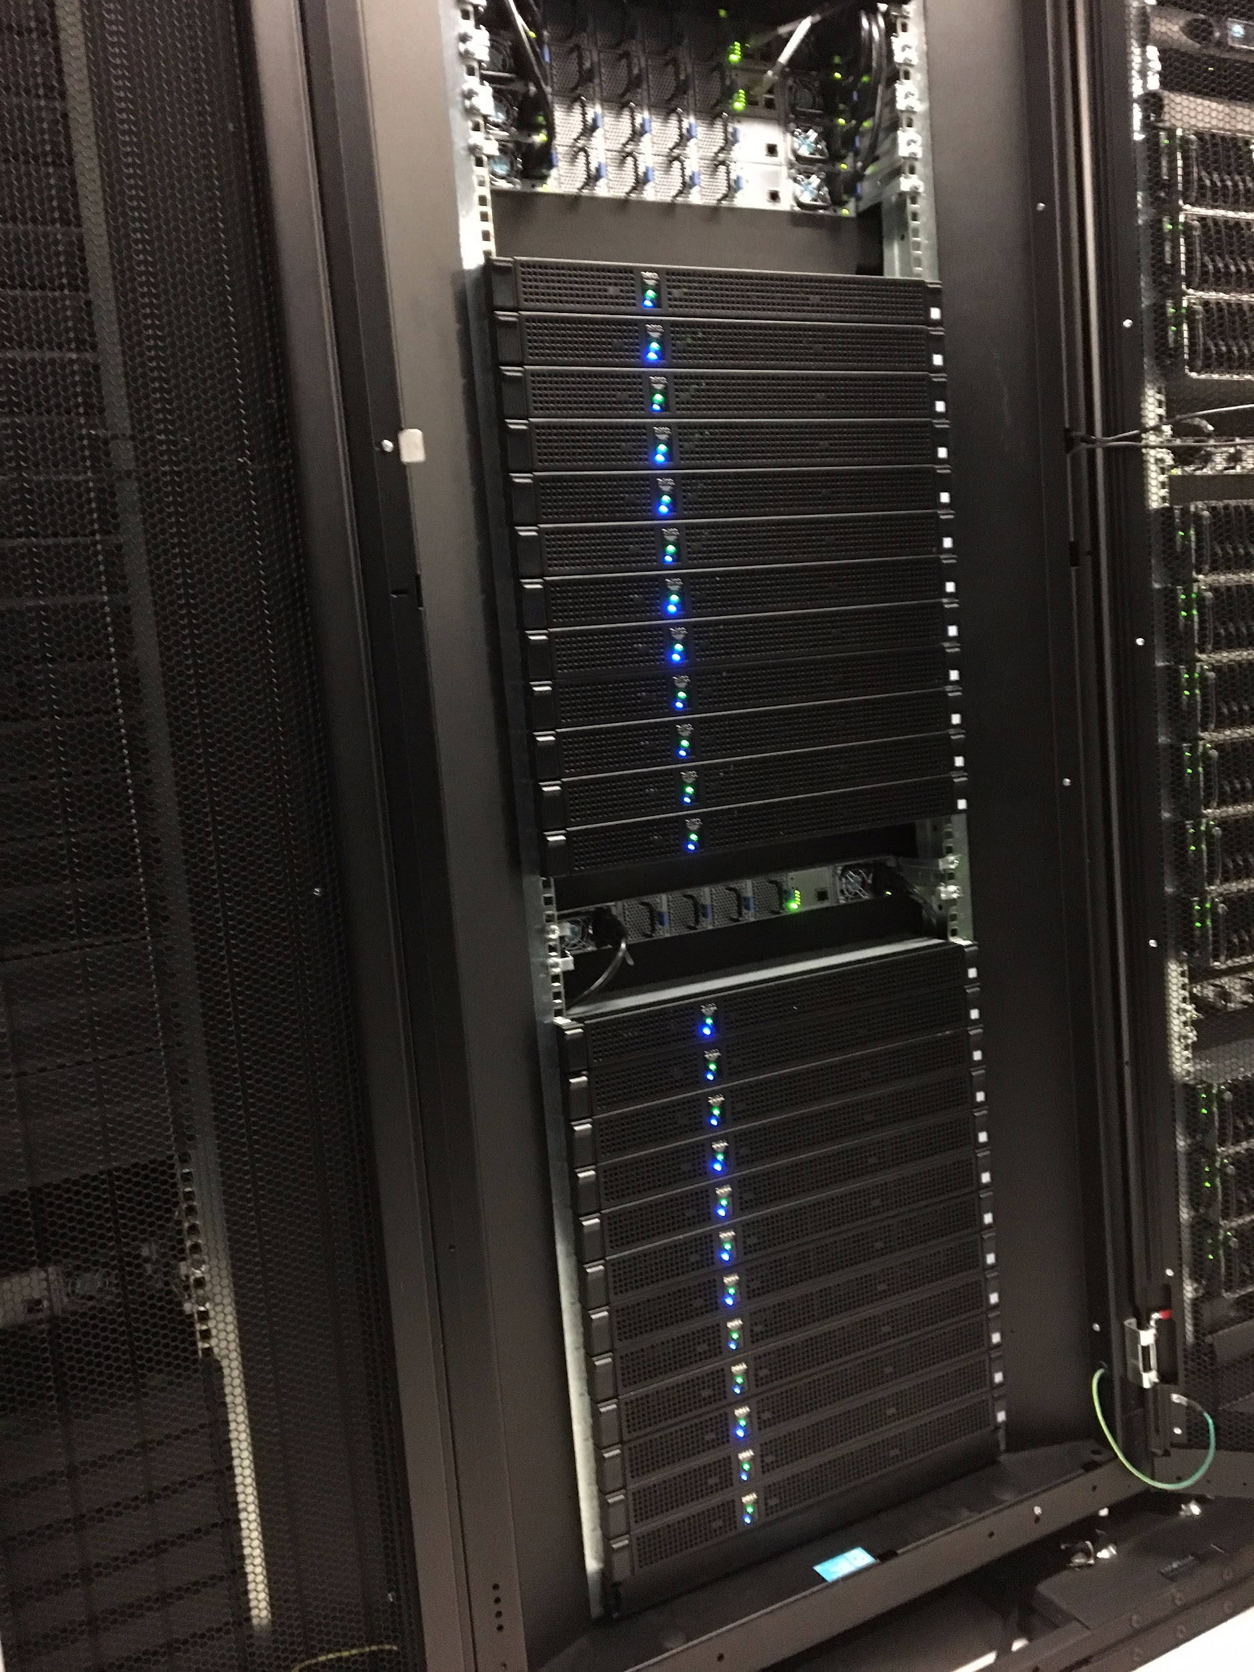
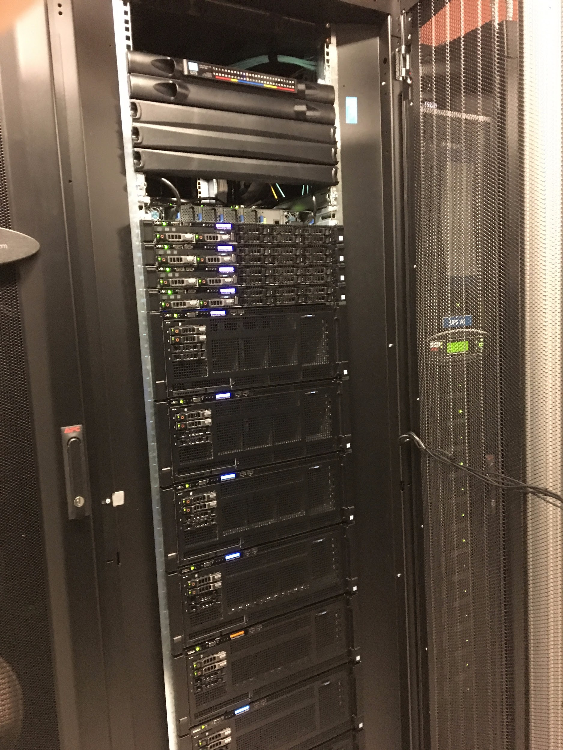
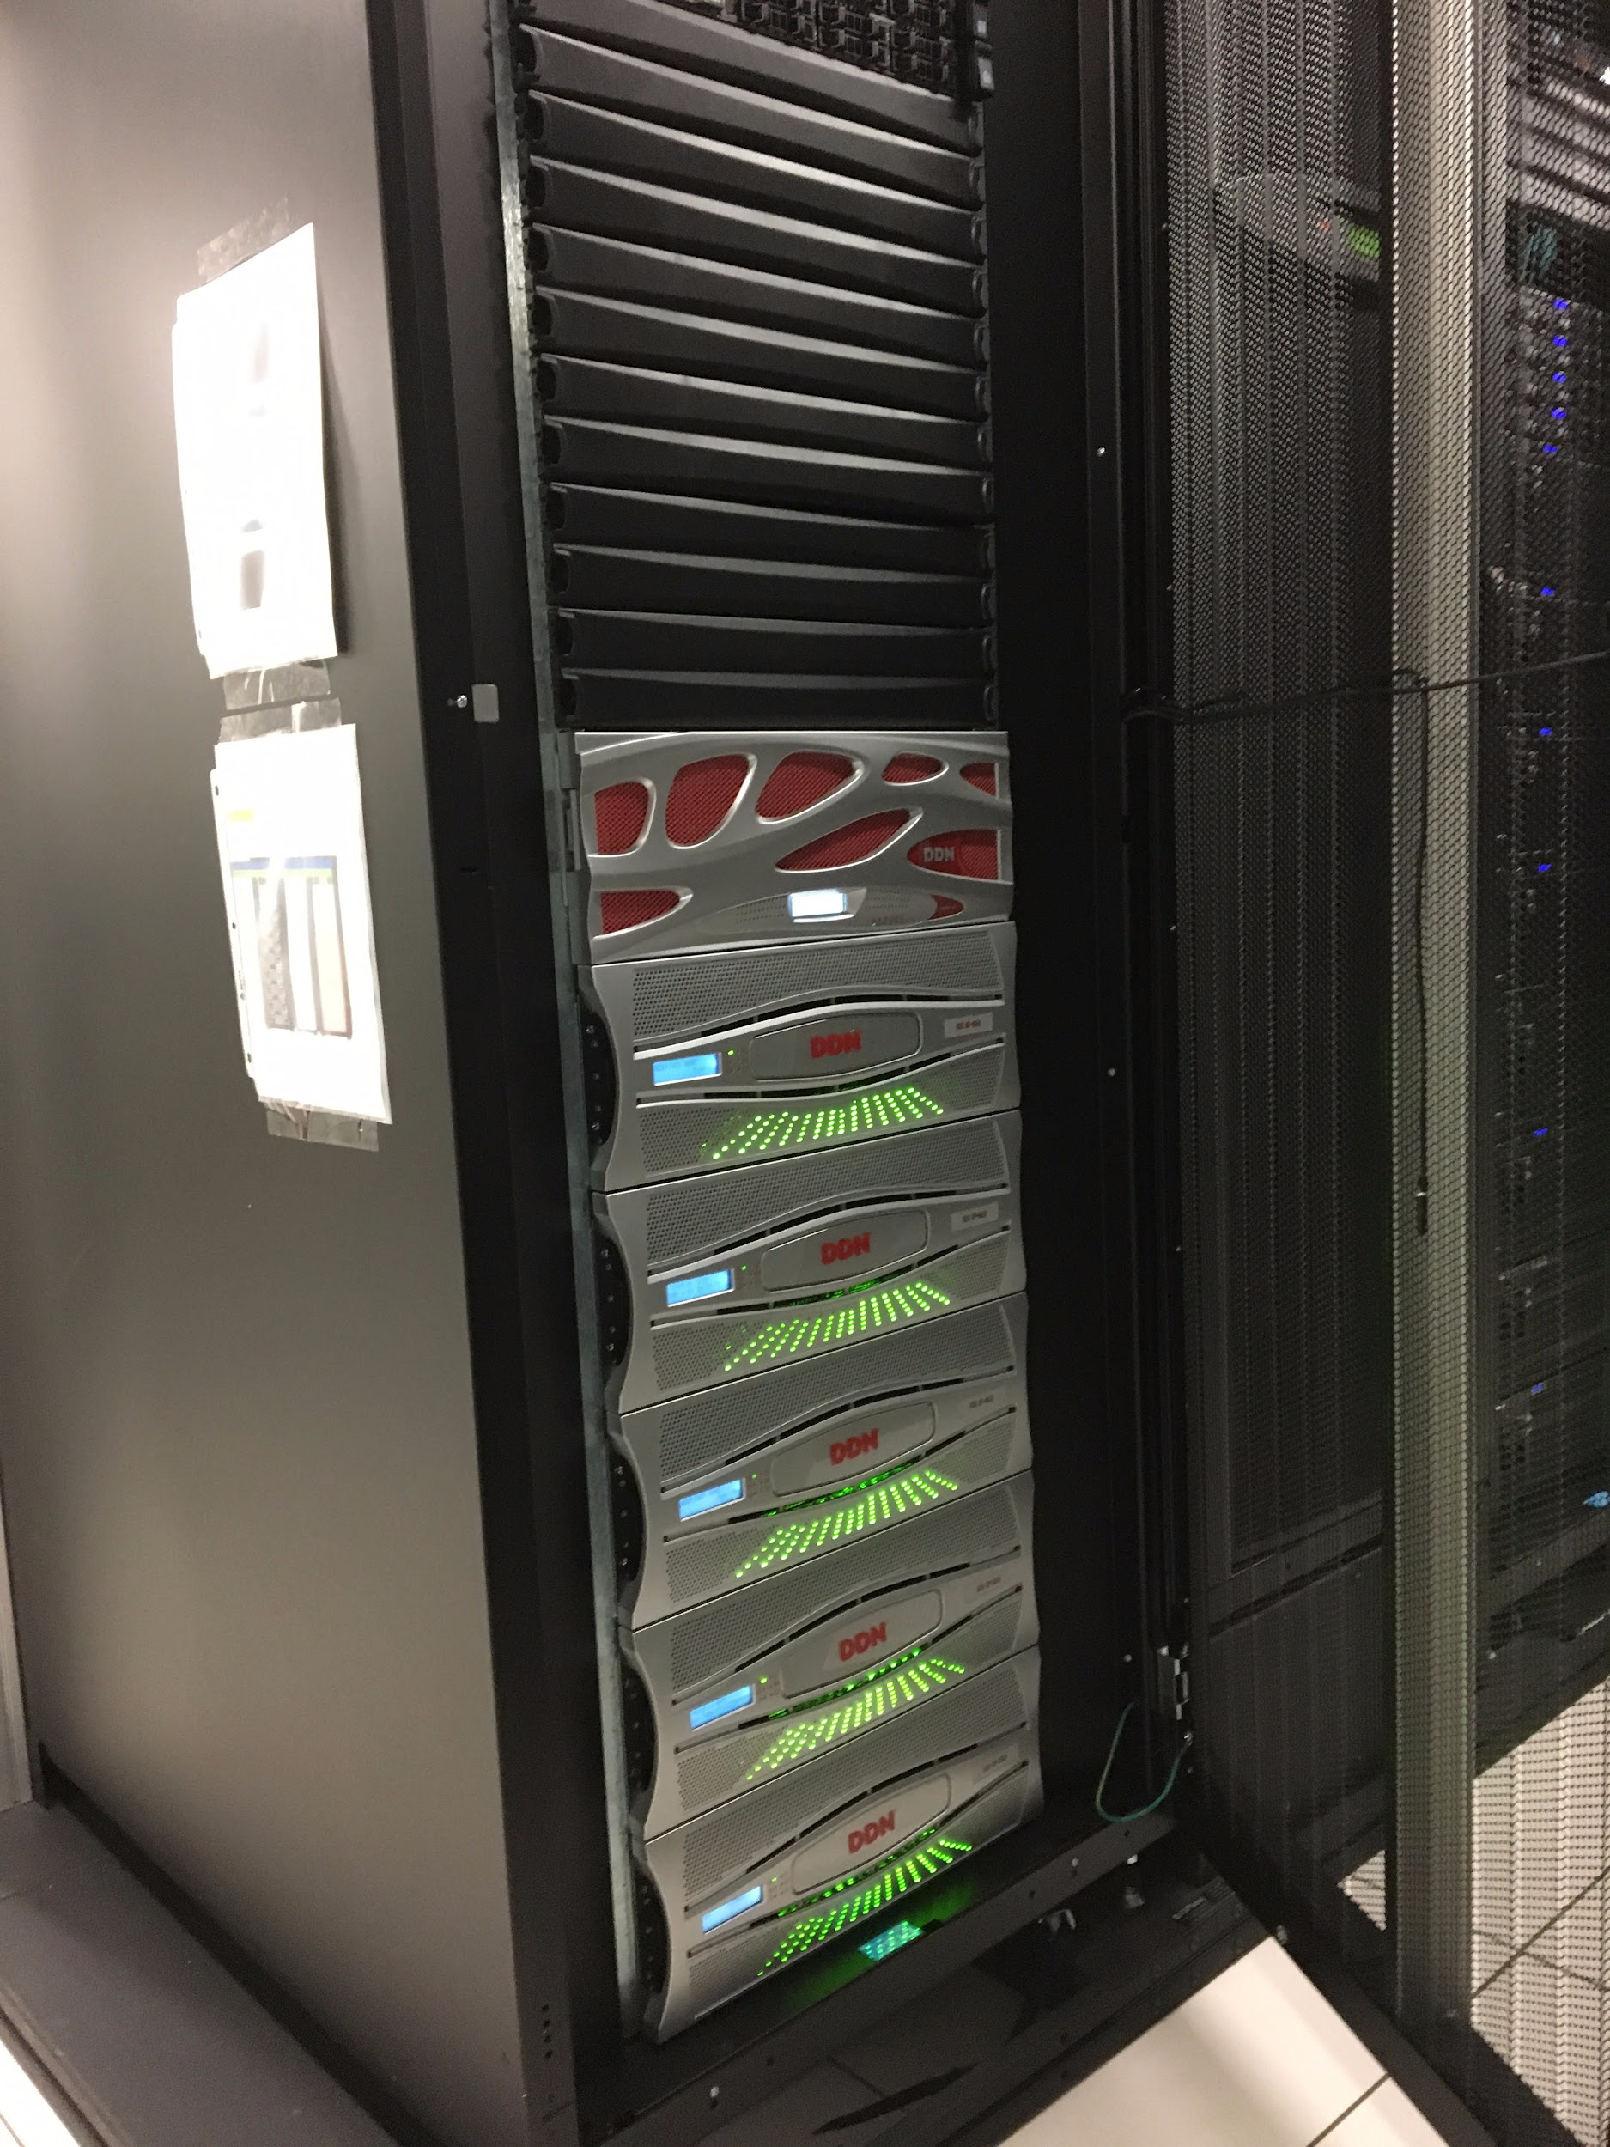
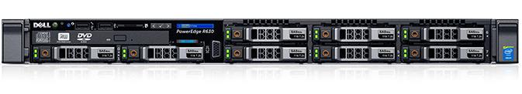
HPC - Talapas
Standard Compute
GPU Nodes
Big Memory Nodes
Network Attached Storage (1.5PB)
Login Nodes

Slide 32
Conclusions
ML Starts with Datasets
We’ll spend a lot of this week on the mechanics and pitfalls of creating AI Ready data
ML algorithms work as universal function approximators
This makes them tremendously flexible

